Slide 1
The Town of Windsor
Berkshire
UK

Slide 2
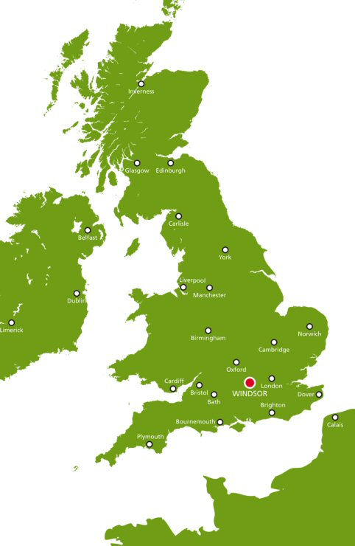

Slide 3
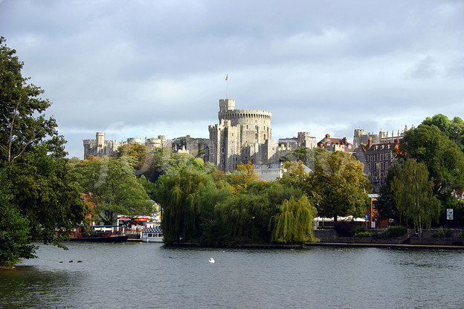
Windsor and River Thames
The small town of Windsor lies on the south bank of the River Thames, 22 miles west of the center of London.

Slide 4
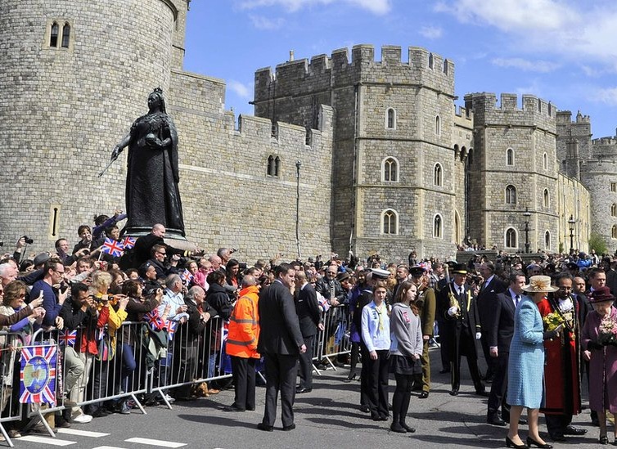
population
Windsor has a population of over 31,000 people.

Slide 5
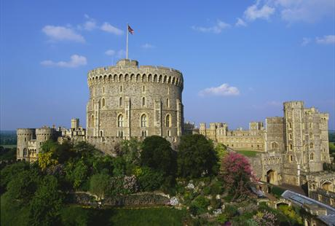
Windsor castle
Windsor Castle is home to Her Majesty Queen Elizabeth II. It is the largest inhabited castle in the world and has been a Royal home for over 900 years.

Slide 6
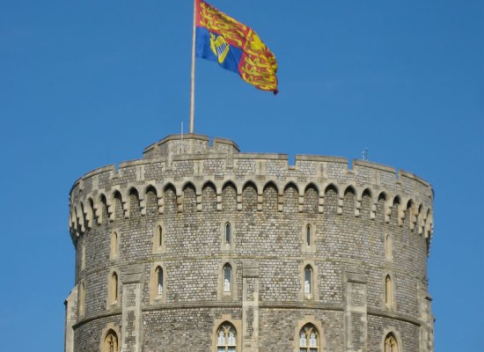
Royal Standard flies over Round Tower in Windsor Castle
Windsor Castle always has a flag flying over it. When Her Majesty is in residence, the Royal Standard flies.

Slide 7
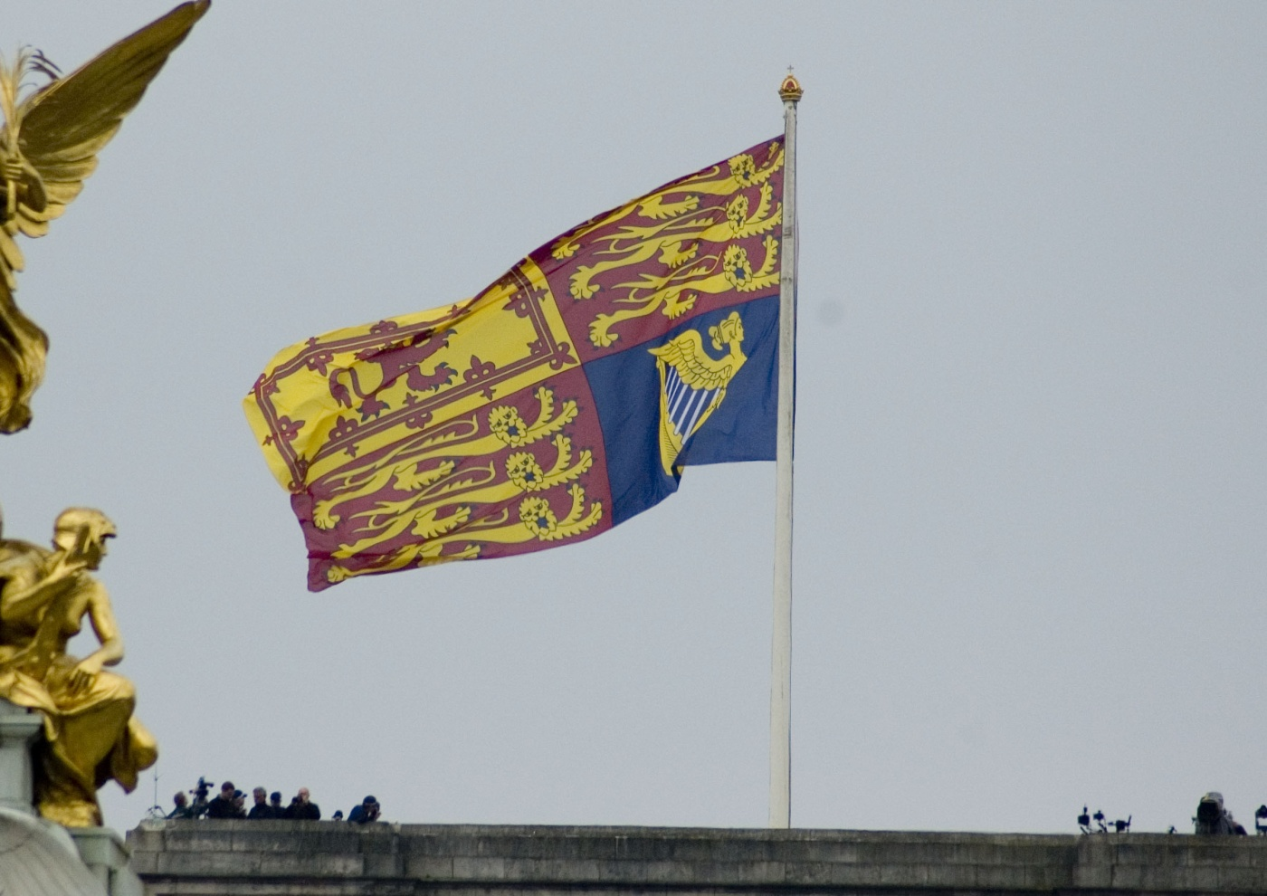
Royal Standard
The size of the flag depends, usually, on the weather/wind conditions, but on birthdays—real and official—the flag is supersize and is visible from miles around when there is a good breeze.

Slide 8
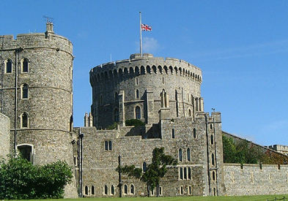

Union Jack is raised at all other times
The Union flag (Union Jack) flies over the round tower at Windsor Castle when Her Majesty is not in residence.

Slide 9
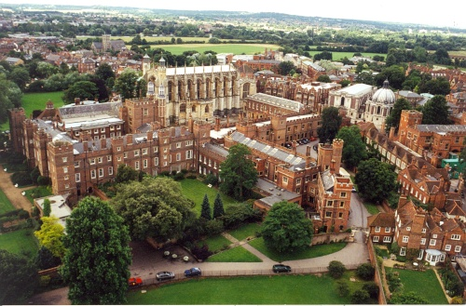
Eton College
The small town of Eton is situated on the north side of Windsor Bridge and is famous for its college, founded in 1440 by Henry VI.

Slide 10
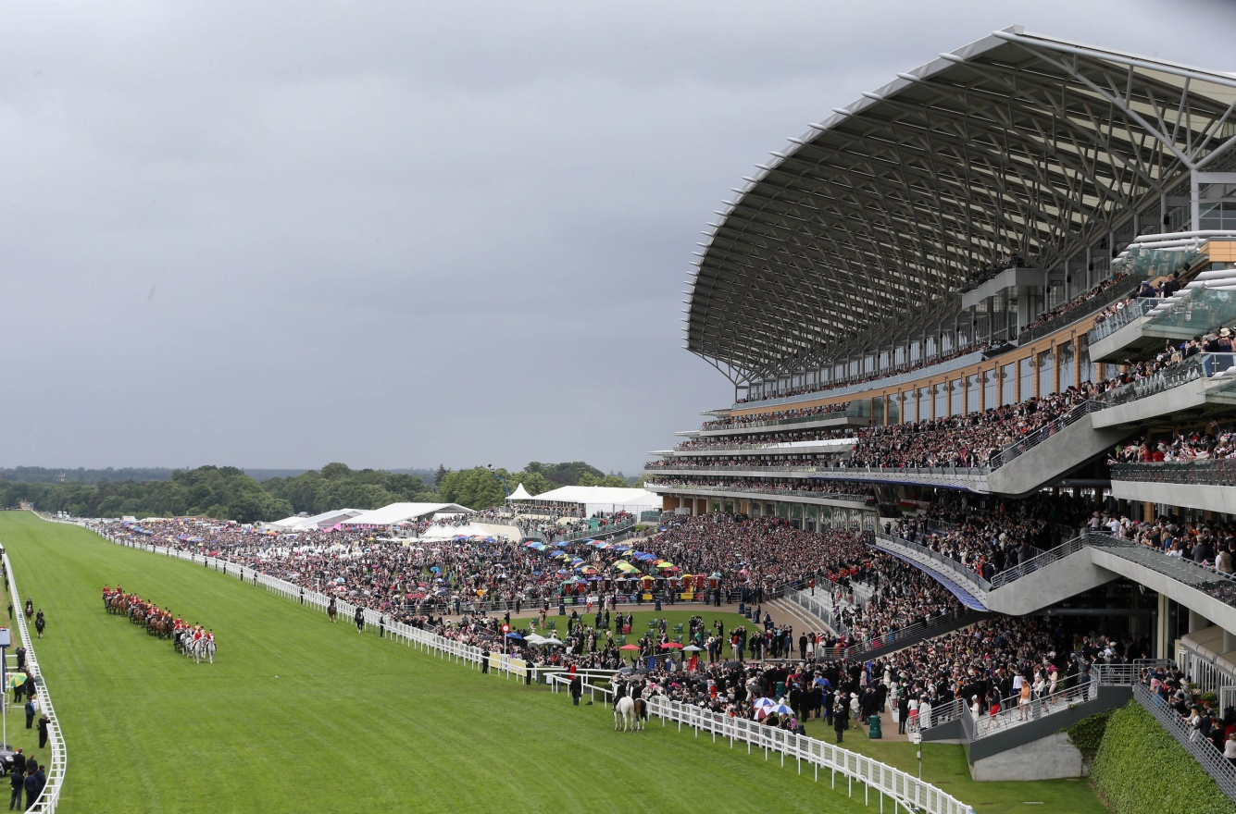
Ascot racecourse
England's most famous racecourse. It's only six miles from Windsor Castle. Ascot is used for thoroughbred horse racing.

Slide 11
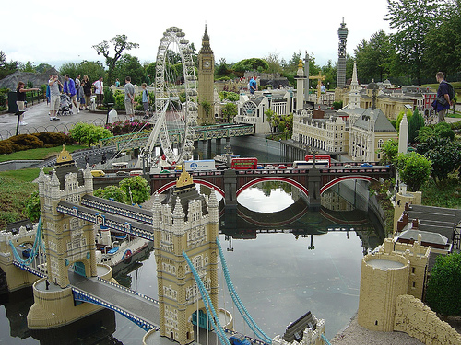
Legoland windsor resort
Legoland Windsor Resort also known as Legoland Windsor is a child-oriented theme park and resort.

Slide 12
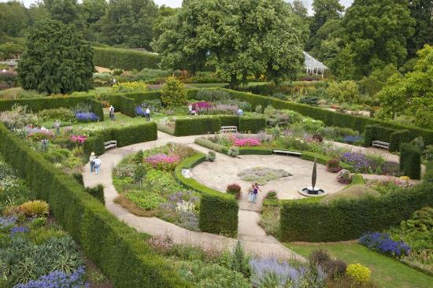
The Savill garden
The Savill Garden is an enclosed part of Windsor Great Park in England, created by Sir Eric Savill in the 1930s. It is managed by the Crown Estate and charges an entrance fee.

